Slide 1
I understand the term
‘Sexting’
What devices do you use that take photos?
Notes:
Introduce the learning objective to the children. Have they ever heard of ‘Sexting’ before?
Give the children 1 minute to share their ideas of what devices they can take photos on. – Phone / Tablet / Ipad / Camera / Video Camera / Nintendo DS

Slide 2
What is the one thing that all of these apps have in common?
Notes:
Do any of the children use the apps shown here?
Skype / Instagram / Youtube / Twitter / Mail
Facebook / Tumblr / Whatsapp / Pintrest / Kidtube / Snapchat
Give the children time to talk to their tables to discuss what the apps all have in common?
They will suggest lots of things but the main point is that they all enable us to SHARE things.

Slide 3
What is Sexting?
“When someone shares sexual messages or naked / semi-naked images and videos.”
Why might people Sext?
Notes:
What is sexting? – Read the description to the children and make sure they understand this can still include between ‘boyfriend and girlfriend’
Why might people Sext? – Allow children time to talk sensibly to their tables about the reasons people might do it, relate it back to Chelsea’s choice for year 8s.
Relationship (Wanting to make their partner happy)
Peer Pressure (Feeling like their friends are doing it)
Media (Maybe they have seen things like this on tv and films.)
Blackmail (Being forced to do it by someone who threatens them by possibly ‘sharing’ the images.)
Exploitation (Being offered rewards like gifts and money to sext people.)

Slide 4
What does the law say?
A young person is breaking the law if…
You take an explicit photo of yourself or a friend.
Share an explicit photo of a child even if it’s between friends.
Store an explicit photo on your device.
The rules above can lead to you having a permanent police record.
Notes:
Read the children the definition of the word ‘Sexting’.
It is important they understand that this doesn’t have to be done just to be ‘sexual’ but can even be ‘innocent’ photos – Them at the beach etc…
Explain to the children that they can have a criminal record at any age, this record is stored permanently! Forever!!!
Make sure the children are clear what the word ‘Explicit’ means. – Clearly showing intimate parts of a person.

Slide 5
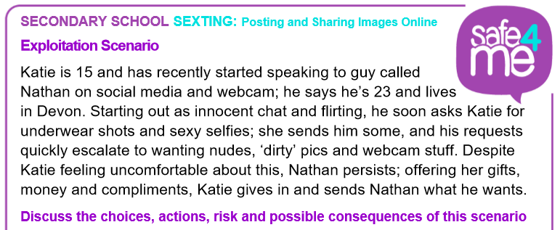
What are Katie’s…
Choices
Actions
Risks
Possible Consequences
Notes:
Read the example scenario with the class. This is about a girl called Katie.
Allow the children time to discuss the subheadings below and then ask them to feedback to the class.
Choices
Chose to speak to the guy
To send him pictures
Accepts Gifts
Actions
Sends ‘dirty’ pictures
Risks
Could have pictures shared
Doesn’t know who she’s talking to
Possible consequences
Could be blackmailed with photos
Could be bullied by others

Slide 6
Your Task
To read your scenario with your group.
What are your…
Choices
Actions
Risks
Possible Consequences
Can you write you own version of the scenario with a better ending?
Notes:
Children to be split into small groups (2’s / 3’s) and given a printed scenario.
Children to work together to try and identify all of the
Children to fill their page with ideas for each of the subheadings and then write their own version of the scenario with a safer ending.
Choices
Actions
Risks
Possible Consequences

