Slide 3
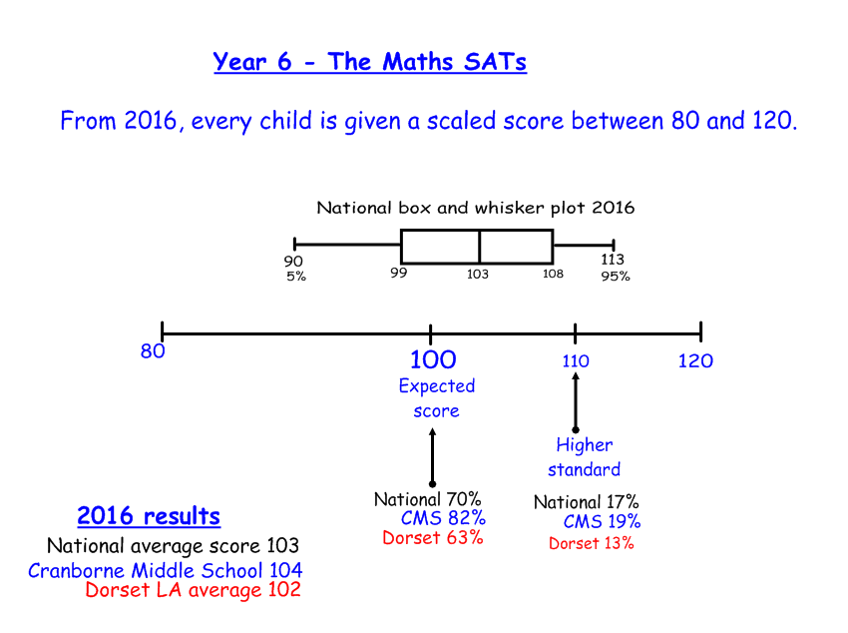

Slide 4
Year 7
 | Cranborne Middle School | National average
High KS1 attainment | 46% | 29%
Medium KS1 attainment | 51% | 60%
Low KS1 attainment | 3% | 11%
Year 6
 | Cranborne Middle School | National average
High KS1 attainment | 42% | 31%
Medium KS1 attainment | 52% | 59%
Low KS1 attainment | 6% | 10%

Slide 5
