Slide 1
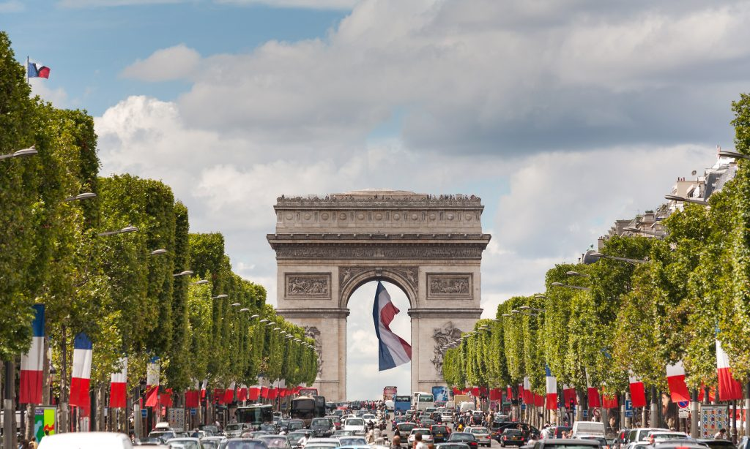
Cranborne Middle School,
Year 8 Trip to Paris
Monday 26/06/2023 – Friday 30/06/2023

Slide 2
Tour basics
Why are we going?
We’re on our way!
What will we see & do?
About our travel company

Slide 3
Tour basics
Why are we going?
We’re on our way!
What will we see & do?
About our travel company

Slide 4
Tour basics
Getting there
We will depart from Cranborne Middle School by coach on
Monday 26th June at 4am and will arrive in Dover at approx 8am
for a 10am ferry.
Please drop your child off at school at 3.30am for a 4am departure.
Returning home
We will leave Calais at 3pm (local time) on Friday 30th June
and arrive home at approx. 9.30pm.
Please collect your child at school at approx. 9.30pm.

Slide 5
Tour basics
Our accommodation
We will stay at ‘Premiere Classe Roissy CDG - Paris Nord 2’ in Paris for 4 nights.
Pupils will be staying in a mix of twin and triple rooms, groupings will be organised and agreed at school…

Slide 6
Tour basics
Meal arrangements
Breakfast will be at the hotel each morning.
Lunches and dinners will be a mix of provided packed-lunches, pre-booked restaurants and own choice for dinner for the day of Disney.
Restaurant meals will either be buffets, or pupils have been asked to pre-select their menu choices, so that they are happy with their selections.
All sites cater for vegetarian, vegan and allergen-free requirements.

Slide 7
Tour basics
Travel tips – money
The currency in Paris is the euro…
Pupils will have the opportunity, if they so desire, to purchase items in the shops at Disney on Thursday and also in the little shops on the Rue Mouffetard during our time visiting there.
We may also have the opportunity to visit a nearby French supermarket, where they will be able to buy snacks, etc.
When pupils arrive at the coach to depart on Monday morning, they need to hand in £30-£40 in a named envelope, which can then be saved for them for the latter half of the week - for dinner and shop purchases during our day at Disney and for snacks etc on the ferry home.

Slide 8
Tour basics
Travel tips – packing
The weather in Paris in June is likely to be warm and dry!
We will be outdoors, indoors and walking as well.
As such, we recommend that students pack the following essential items for their tour:
- Inhaler / epipen (if required).
Sun hat & cream
Light waterproof coat
Comfortable shoes 7 appropriate clothing
Small bag with secure pockets for money, etc.
Water bottle!
CMS jumper / hoodie for on the ferry.

Slide 9
Tour basics
Why are we going?
We’re on our way!
What will we see & do?
About our travel company

Slide 10
Why are we going?
To practise all the fantastic French vocabulary and conversational skills we have learnt whilst at Cranborne!
To immerse ourselves in the language and culture of another place.
To see some of the most famous sights in the capital city of the country we have been studying.
To develop our sense of wonder, curiosity and exploration.
To have fun!

Slide 11
Tour basics
Why are we going?
We’re on our way!
What will we see & do?
About our travel company

Slide 12
On the coach
Seat belts MUST be worn.
Noise levels must be kept at an acceptable volume so as not to distract the drivers.
Luggage size – You will carry your own luggage so, don’t go crazy!

Slide 13
On the ferry
Pupils need to check in with the adult at our meeting point every half hour and stay in groups of 3 to 4 at all times.
Pupils must act responsibly at all times.
Pupils are to wear their CMS jumpers for the ferry.
There are some small shops and cafes on the ferry.
(But don’t spend all your money already!!)
Bring motion sickness tablets / wrist bands if needed.
You can only go on an outside deck with an adult.

Slide 14
Electronic Equipment
Phones may not be taken on the trip at all, due to safeguarding issues. Any phones discovered will be confiscated for the duration of the trip and parents informed.
Electrical items with no WIFI chat functions, like old-style iPods and game devices (e.g. a handheld Nintendo switch) may be taken to be used whilst travelling. (Remember your chargers).
iPads and new ipods will not be allowed as they can still be used for video communication via WIFI.
You may bring a camera to take out and use for photos instead. A disposable camera may be a good idea…? (Remember chargers!)

Slide 15
Monday 26th June:
03:30 hrs | Meet at school to load luggage ready for departure.
04:00 hrs | Group to depart from the school via the coach provided by NST.
07:55 hrs | Group to check in at P & O Ferries Terminal Dover.
09:55 hrs | Ferry departs Dover Ferry Terminal.
12:25 hrs | Ferry arrives in Calais Terminal (Local Time).
15:30 hrs | Anticipated arrival and check in at the hotel.
16:00 hrs | Group to meet the Coach and depart.
17:00 hrs | Group to arrive at the Jardin des Tuileries and the Louvre Museum for a visit and photo opportunity.
18:00 hrs | Group to meet the coach and depart.
19:00 hrs | Arrive for a dinner at East Bunker Restaurant.
20:00 hrs | Group to meet the coach and depart.
21:00 hrs | Arrival back at the accommodation.
What will we see & do?

Slide 16
Tuesday 27th June:
09:00 hrs | Group to meet the coach and depart the accommodation.
 | Spend the morning visiting the Sacré-Cœur and Montmartre area.
12:00 hrs | Group to eat packed lunches, then meet the coach and depart.
13:40 hrs | Arrive for a confirmed self Guided visit to Chateau de Versailles.
15:40 hrs | Group to meet the coach and depart.
17:20 hrs | Arrive for a confirmed visit at the Arc de Triomphe.
18:30 hrs | Group to walk to the Monte Carlo Self Service Restaurant.
19:30 hrs | Group to meet the coach and depart.
21:00 hrs | Anticipated arrival at the accommodation.
What will we see & do?

Slide 17
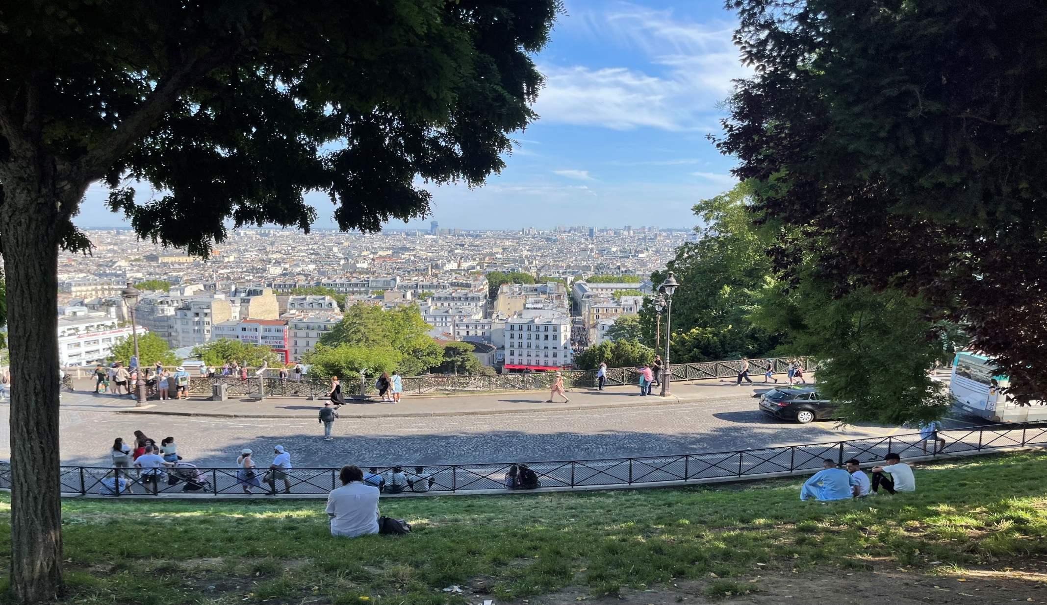

Slide 19
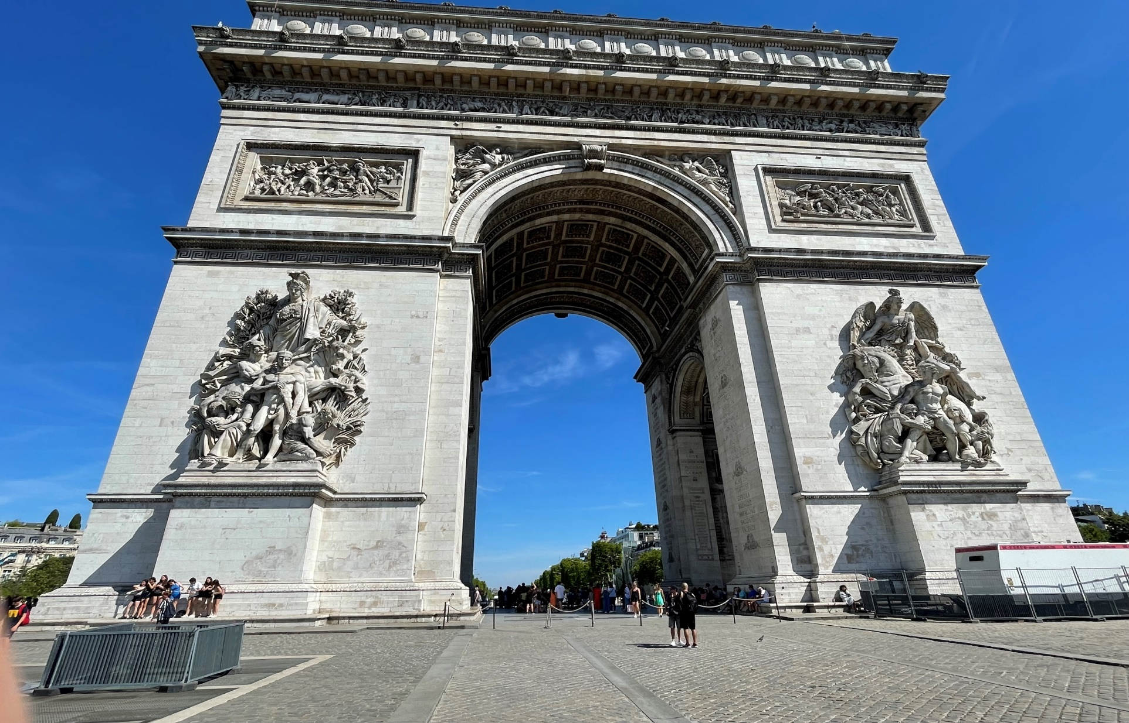

Slide 20
Wednesday 28th June:
08:45 hrs | Group to meet the coach and depart the accommodation.
10:00 hrs | Arrive for a confirmed non-guided visit to Musee d'Orsay.
12:00 hrs | Group to picnic in the Jardin De Tuilieries.
13:30 hrs | Arrive for a visit to Musée Gourmand du Chocolat - Choco-Story.
14:30 hrs | Group to meet the coach and depart.
15:00 hrs | Arrive for a 1 hour return cruise on the River Seine.
16:30 hrs | Group to walk to the Eiffel tower to view externally and the Tracadero Gardens for Photos.
18:30 hrs | Arrive for dinner at the Hard Rock Cafe.
19:30 hrs | Group to meet the coach and depart.
20:45 hrs | Arrive at the accommodation.
What will we see & do?

Slide 21
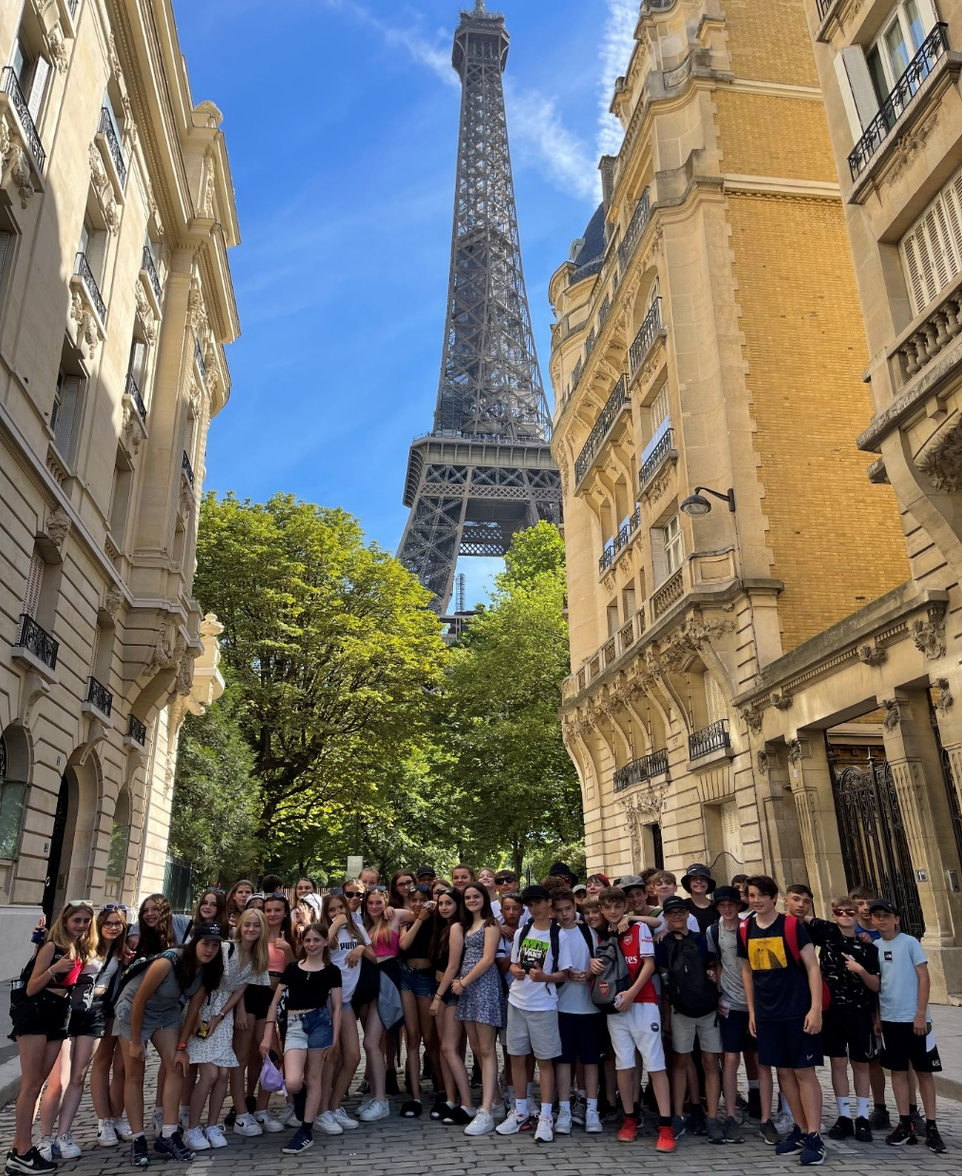
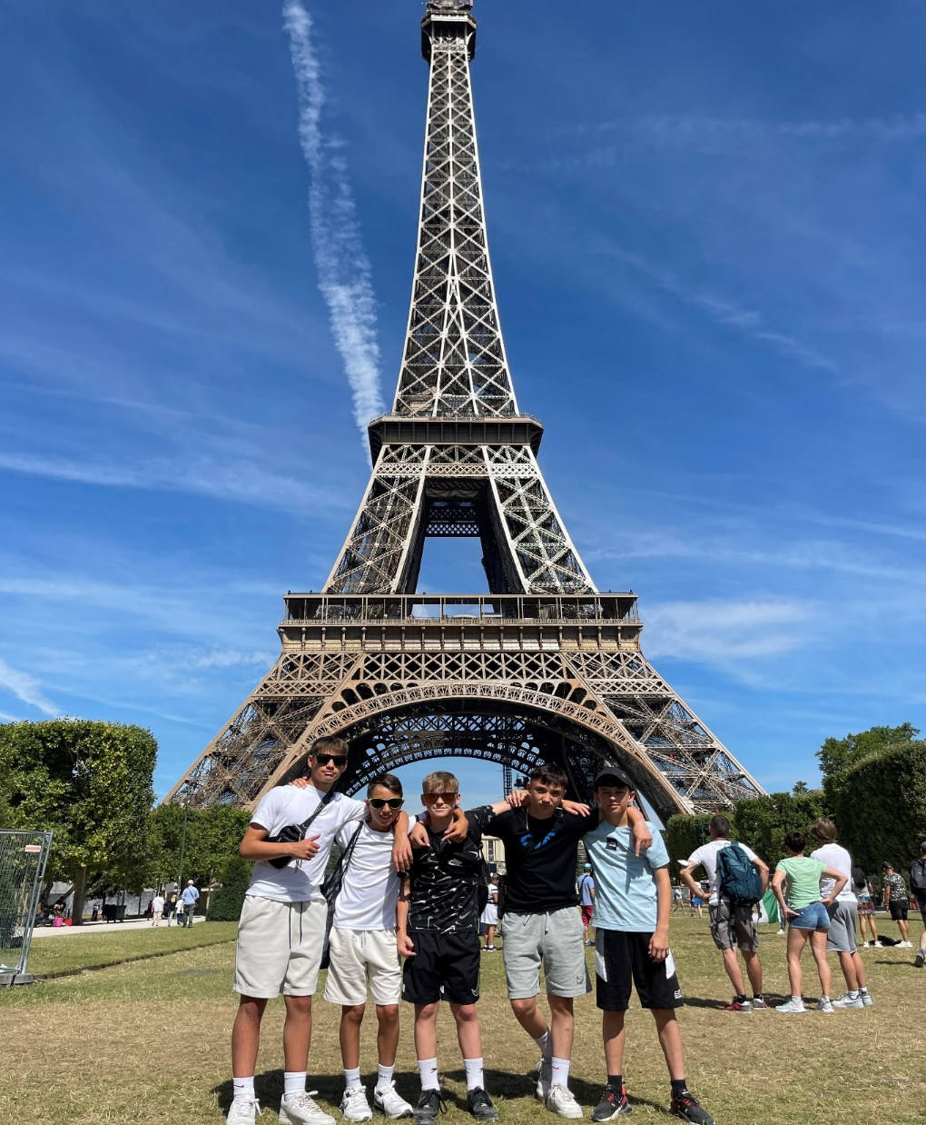

Slide 22
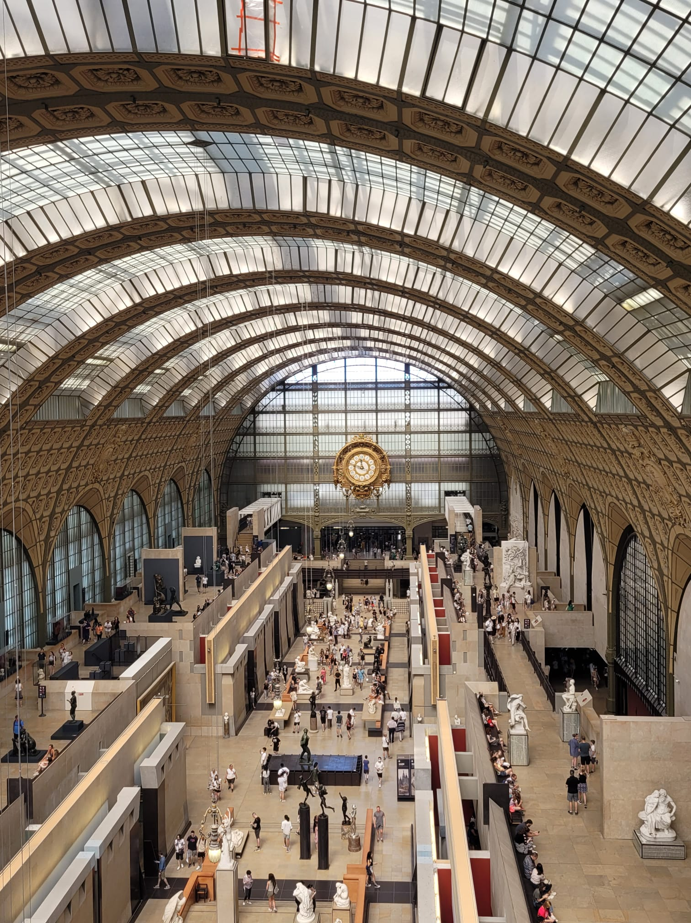

Slide 23
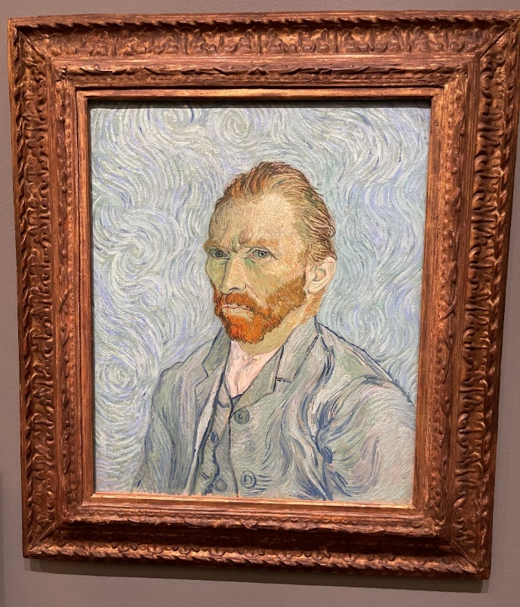
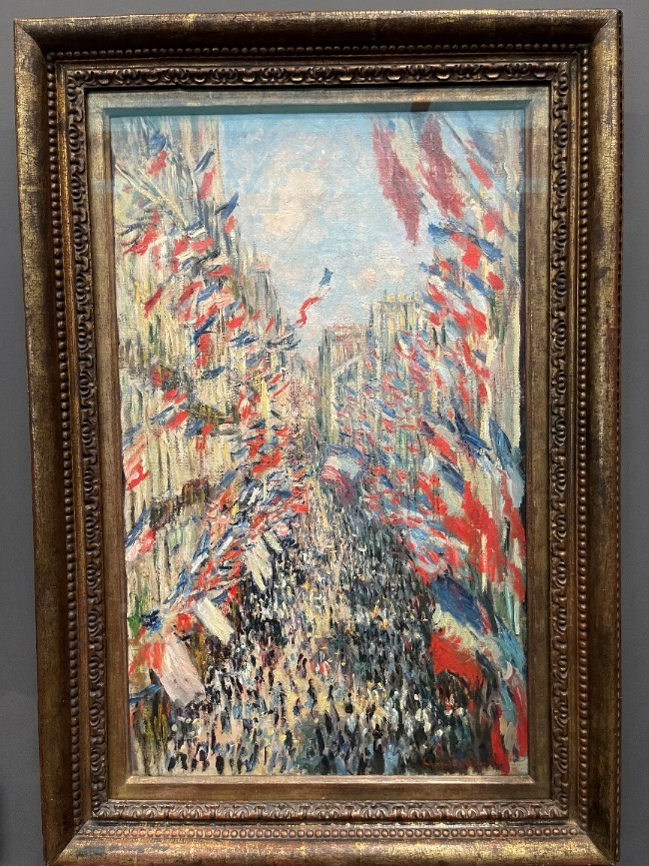

Slide 25
Thursday 29th June:
8.45am – Group departs hotel.
10am – Group arrives at Disneyland Paris
8pm – Group departs Disneyland Paris.
9pm – Group arrives back at hotel.
What will we see & do?

Slide 26
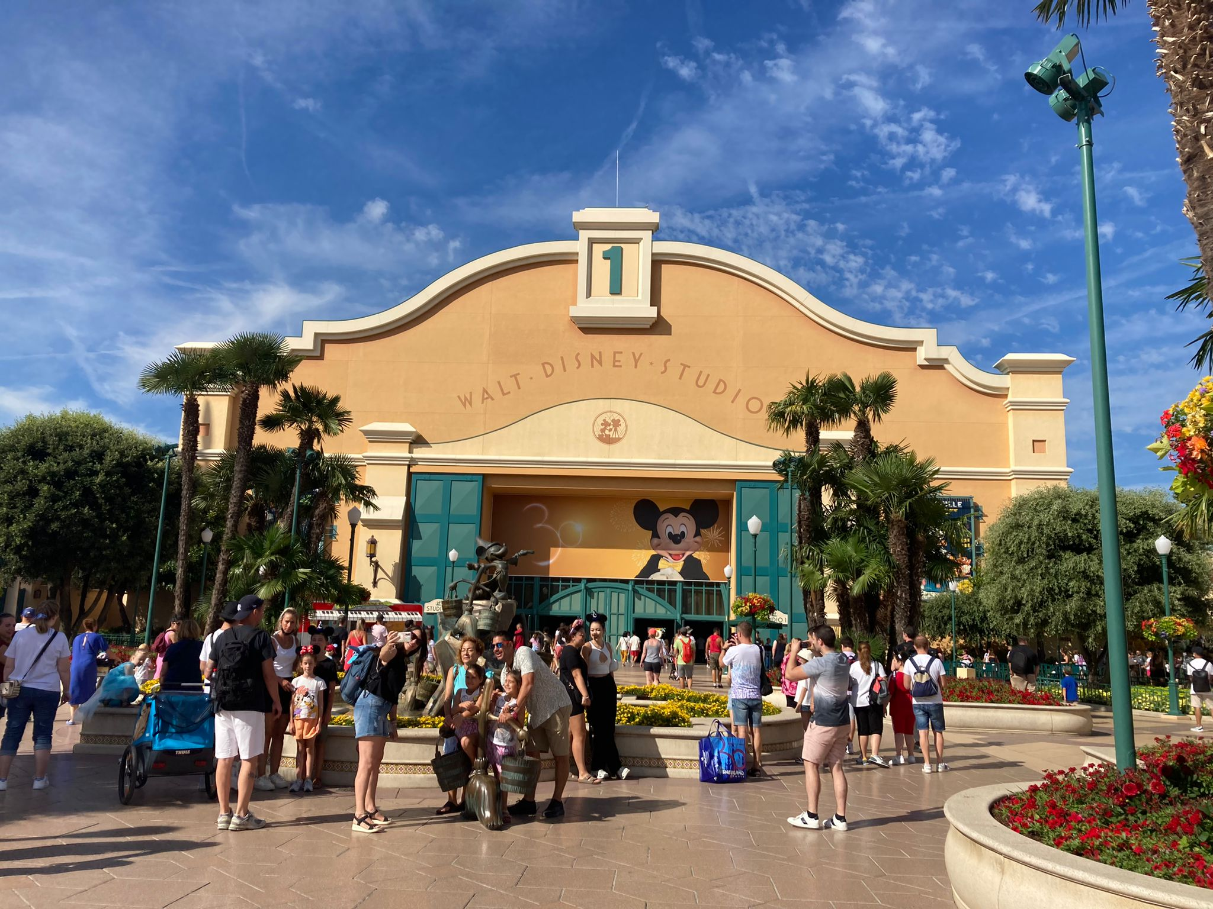

Slide 27
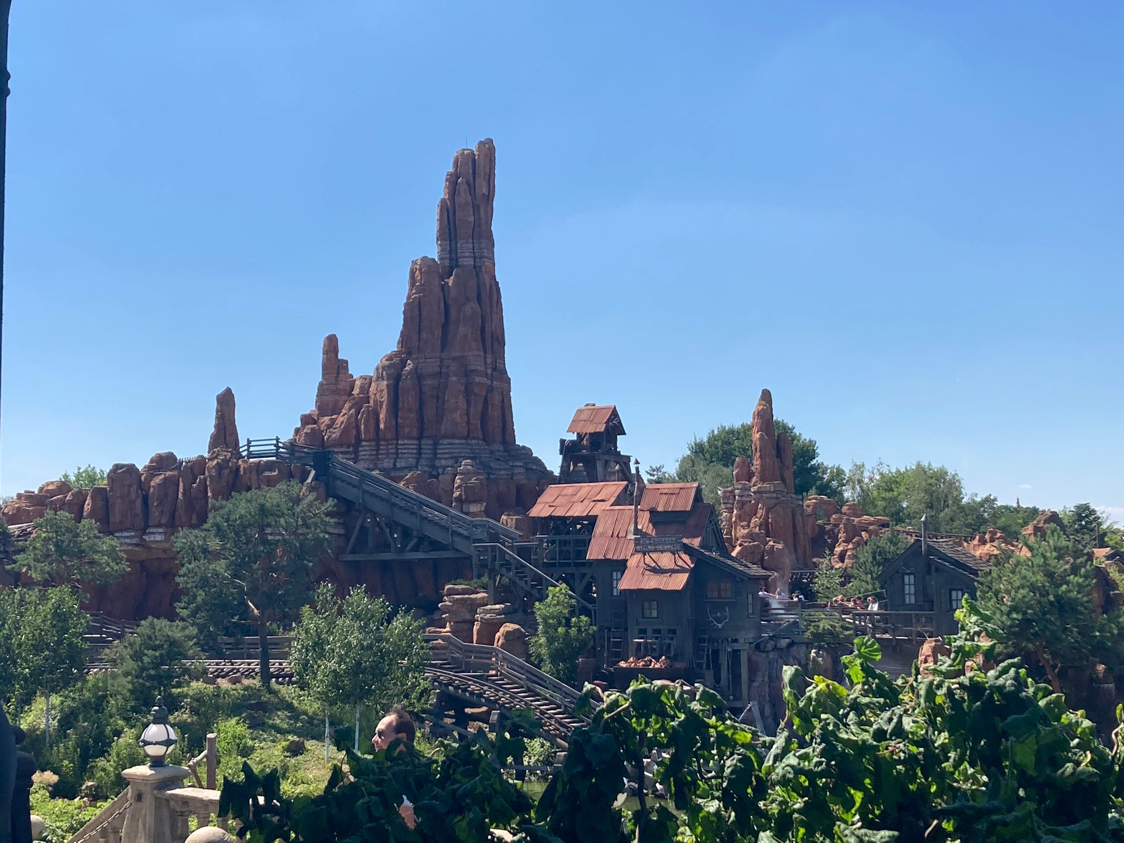

Slide 28
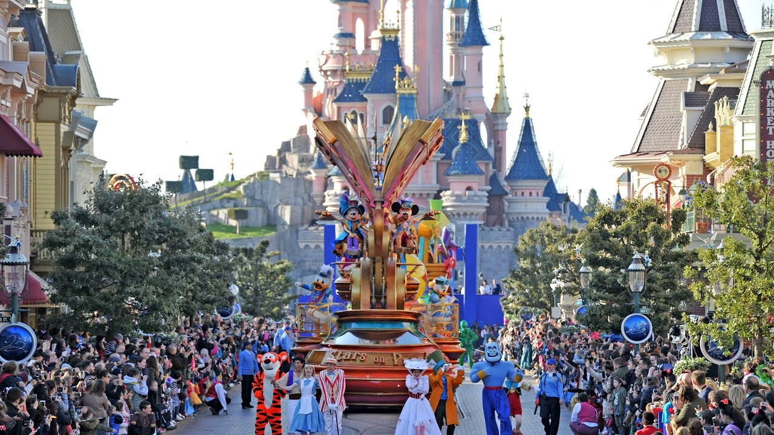

Slide 29
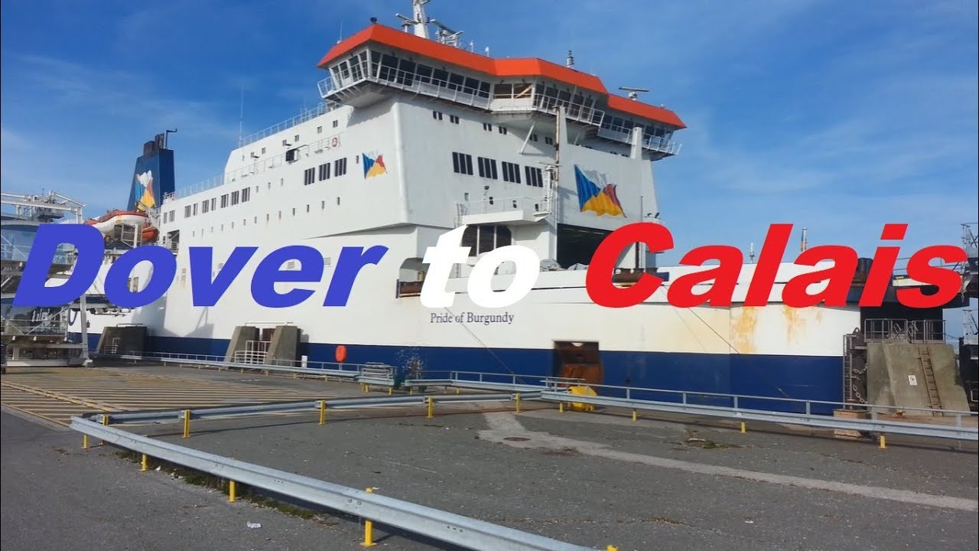
Friday 30th June:
09:00 hrs Group to meet the coach and depart the accommodation.
13:00 hrs Group to arrive and check in at the P&O Ferries Terminal Calais.
15:05 hrs Ferry Departs Calais (Local Time).
16:20 hrs Ferry arrives in Dover (Local Time).
21:30 hrs Anticipated arrival back at school.
What will we see & do?

Slide 30
Keeping up to date with our adventures…!
“We will be sharing photos of our trip to Paris with you whilst we are away via our social media platforms.
Please log in to Instagram (@cranbornemiddleschool) or Twitter (@CranborneMiddle) to follow regular updates of our trip. Twitter updates will also appear on the main page of the school website.

Slide 31
Tour basics
Why are we going?
We’re on our way!
What will we see & do?
About our travel company

Slide 32
Established 1967 - over 45 years’ experience
Government recommended health and safety policy
ABTA and ATOL protected - your payments are insured
Insurance cover and 24-hour medical assistance cover
About our travel company

Slide 33
Tour basics
Why are we going?
We’re on our way!
What will we see & do?
About our travel company

Slide 34
Don’t forget…
Passports, money and GHIC card.
(Please send copies of your passport and GHIC card to the school office asap if you have not already done so!)
Drop your child off at school at 3.30am on 26/06/23.
Collect your child at approx. 9.30pm on 30/06/23.
If you have any questions or emergencies whilst your child is away, please call the school office or, out of hours, call Mr Stevens on the emergency phone. The number for this will be sent out via parentmail nearer the time.
We’re on our way!

Slide 35
Any questions?

