Slide 1
YEAR 6 SATS 2020

Slide 2
What are SATs for?
THE BIG PICTURE
Each pupil has a milestone assessment done at the end of each stage of their education – Y2, Y6 and GCSEs.
Y6 SATs are used to see how much progress
has been made since Y2.
They assess how ready pupils are to move onto their next stage of education.
They monitor school performance from
year to year.
AT CRANBORNE
We are now measured on the progress made from the start of Y5 to the end of Y8, so Y6 SATs are a mid-point assessment for their time here.
Developing skills such as revision, test confidence, resilience.
Assessing how ready pupils are for starting their next stage of education.

Slide 3
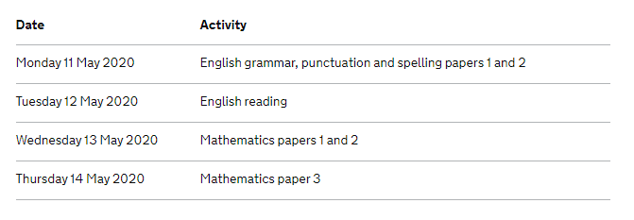
How are SATs organised?
Tests take place in the rooms where the English and maths lessons are held.
Pupils who are allowed readers, extra time, prompts or scribes are supported in different rooms from one to one to small groups.
Tests are posted away to be marked by other trained teachers.
Results are sent to us around the start of
July.
Writing is assessed by class teachers and is based on a collection of about
6 pieces of writing. This is graded towards the end of June.
Pupils receive a ‘standardised score’. This means they are aiming to score at least 100 in each test.
A score of 110 indicates a real
confidence in that test – ‘greater depth’.
A score of under 100 means a resit in Y7.

Slide 4
What is the content of the tests?
Grammar, punctuation and spelling:
Around 45 questions on word types, use of different punctuation, meaning of words and grammatical terminology.
A separate spelling test of 20 words.
The test is out of 70 marks – a pass mark of 36 was needed in 2019 (55 for Greater Depth).

Slide 5
What is the content of the tests?
Reading:
Three texts, of supposed increasing difficulty, which could be any combination of story, poetry and non- fiction.
Around 35 questions on retrieval, inference, word meaning, summarising and comparisons.
The test is out of 50 marks – a pass mark of 28 was needed in 2019 (41 for Greater Depth).

Slide 6
What is the content of the tests?
Writing:
No test!
Assessment throughout Y5 and Y6 against a list of criteria to be met for each grade.
The list is not ‘best fit’ – with the exception of handwriting, all criteria have to be met, or a lower grade is awarded instead.
In very specific situations, an exemption for one of the criteria can be used. E.g. spelling.

Slide 7
What is the content of the tests?
Maths:
Three different papers – Arithmetic, and two reasoning papers.
Arithmetic is 36 questions in 30 minutes. The four operations, fractions, decimals, percentages and BIDMAS are covered.
Reasoning papers – around 20 questions in 40 minutes. These cover all aspects of the KS2 curriculum and take the form of worded problems, multiple choice, diagram drawing etc.
The test is out of 110 marks – a pass mark of 58 was needed in 2019 (95 for Greater Depth).

Slide 8
How can I support my child?
Homework
Some pupils are able and confident to work independently on their homework – in this case, it would just be a matter of checking they have completed it correctly and to a high standard. Other children require different degrees of support. As long as we are aware that you have helped with the homework, that is not a problem – better that than homework completed incorrectly that doesn’t improve their understanding.
Spelling Shed
Times Tables Rockstars
Maths and SPaG Home Learning workbooks.
Attendance
Revision
Practice test papers
This year, we are going to pay for the papers. They will then be used as part of the increase in the amount of homework towards the end of year 6. This is partly for the SATs, but more to prepare them for the change to KS3 next year.
Confidence and self-belief
Being able to manage your emotions, handle a little bit of pressure, and work hard to achieve your best are all key skills we would like our pupils to develop, not for the SATs, but because they are important for the later years of school and beyond.

