Slide 1

I understand the term
‘Sexting’
What devices do you use that take photos?
Notes:
Introduce the learning objective to the children. Have they ever heard of ‘Sexting’ before?
Give the children 1 minute to share their ideas of what devices they can take photos on. – Phone / Tablet / Ipad / Camera / Video Camera / Nintendo DS

Slide 2

What is the one thing that all of these apps have in common?
Notes:
Do any of the children use the apps shown here?
Skype / Instagram / Youtube / Twitter / Mail
Facebook / Tumblr / Whatsapp / Pintrest / Kidtube / Snapchat
Give the children time to talk to their tables to discuss what the apps all have in common?
They will suggest lots of things but the main point is that they all enable us to SHARE things.

Slide 3

Let’s watch Becky’s story.
Notes:
Watch the video from CEOP called Jigsaw.
This video tells the story of a girl who shared some personal photos online and didn’t realise that the rest of the world would be able to see them.
She didn’t know where her photos had gone.
Relate this back to the previous slide which had the social media apps on, this could happen to anyone if they are using those apps!

Slide 4
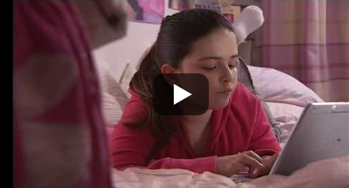
What could have made this worse?
Notes:
Allow the children time to discuss with their tables the ways in which this situation could have been worse?
Had their address or other personal information in the pictures.
Been a more ‘personal’ picture of themselves.
Been a photo that they only wanted a specific person / group to see.

Slide 5

What is Sexting?
“When someone shares sexual messages or naked / semi-naked images and videos.”
A young person is breaking the law if…
You take an explicit photo of yourself or a friend.
Share an explicit photo of a child even if it’s between friends.
Store an explicit photo on your device.
Notes:
Read the children the definition of the word ‘Sexting’.
It is important they understand that this doesn’t have to be done just to be ‘sexual’ but can even be ‘innocent’ photos – Them at the beach etc…
Explain to the children that they can have a criminal record at any age, this record is stored permanently! Forever!!!
Make sure the children are clear what the word ‘Explicit’ means. – Clearly showing intimate parts of a person.

Slide 6

Don’t forget your pants!
Notes:
Go through the Acrostic with the children, try to encourage them to share their ideas about each bullet point as a discussion with the rest of the class.

Slide 7

Let’s decorate our pants
Notes:
Choose one of the sentences with the class. What sort of characteristics of a person would demonstrate this sentence?
Eg:
No Means No
Someone who is willing to stand up for themselves
Understands good and bad decisions.
Isn’t influenced easily by others.
Model decorating your pants by writing the statement you have chosen and then filling them with key words / statements about good practice.

Slide 8

Your Task
You have 30 minutes to decorate your own pants.
What would the model Pants wearer do?
Notes:
Explain the task to the children, they have 30 minutes to create their own Pants Poster to explain about staying safe online.
Children to work in groups of 5.
Each children in their group will be given a different sentence to work from.
Children to decorate their pants with words / pictures that would demonstrate perfect examples and that strategy.
Encourage children to stick to the colour scheme of the acrostic so they can make their own bunting in the theme of the picture.

