Slide 1
I understand the term
‘Digital Footprint’
Has anyone heard of this before?
Notes:
Introduce the learning objective to the children. Have they ever heard of ‘Digital Footprint’ before?
Give the children 1 minute to share their ideas of what apps they recognise from the digital footprint on the board, do any of the children use them at home? – Share examples with the class.

Slide 2
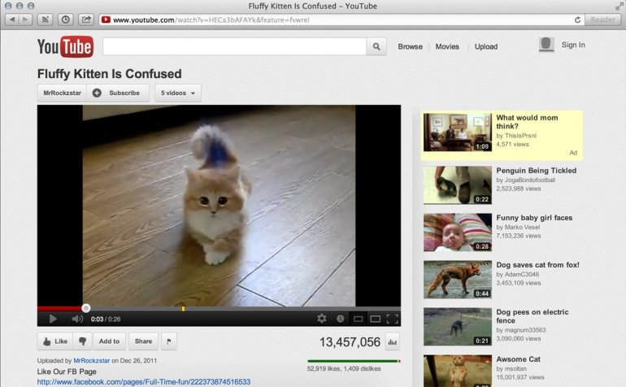
How many different things can you do on a youtube page?
Notes:
Explain to the children that you have been looking at funny cat videos and you decided to ‘Like’ it.
Point out the ‘Like’ button that’s been circled in red.
Allow the children 1 minute to discuss what other things you could do on this page.
- Dislike / subscribe / comment / share / add to playlist

Slide 3
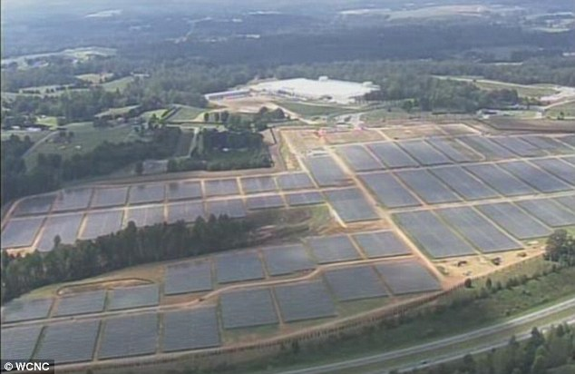
How do websites remember what you have done on them?
Notes:
We have all agreed that we can do lots and lots on websites, but how do they remember what we have done?
This is a picture of a ‘Data Farm’ these are huge warehouses full of harddrives (like usb stick) that store every thing that we do on these websites that we listed on the last slide. This is how websites ‘remember’ what we have done.
The blue picture is inside of a data farm, racks and racks of storage.

Slide 4
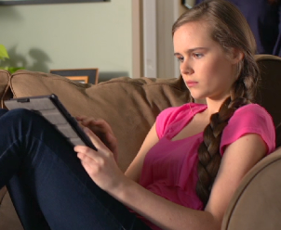
Does this seem familiar?
Click the picture to watch the film
Notes:
Play the video for the children, does this seem familiar to anyone?
What was the girl doing?
- She was sending messages / pictures that she only wanted her friends to see.

Slide 5
Where are all of her pictures and messages stored?
Notes:
The girl was sending pictures and messages, but before they reach her friends, where will they be stored?
Click to reveal the ‘Data Farm’
These act as middle men, storing the information until the other person logs in to see it.

Slide 6
How long is our information stored?
Who owns your pictures that you upload?
Notes:
How long is your information stored?
Permanent, there is no expiry date. What happens when a farm fills up? – The build another! They don’t delete anything!
Who owns your pictures you upload?
The company that owns the app that you upload through…
- Facebook / Instagram / Snapchat etc…

Slide 7
Who can see your images?
Notes:
So who can see your images that you share?
Children might say…
Only the people you send them to
People in your friends list
The answer is ‘Anyone!’ even if you have set your profile to ‘Private’ it’s still possible for anyone to get hold of it!
This is done because people can easily ‘Share’ images with other people.

Slide 8
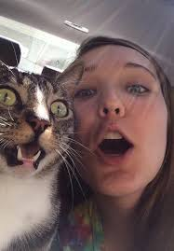
This is claire
Claire sends a picture to 5 of her friends in a group chat.
How many people have seen this picture?
Notes:
This is Claire, she loves taking photos and sharing them with her close friends in a group chat.
She has 5 people in her group chat.
So far 6 people have seen her picture. But her friends profiles aren’t private, they’re public.
What happens next?

Slide 9
Claire’s friends send the picture on to their 5 friends.
How many people have seen this picture?
Notes:
Now Claire’s friends have shared the photo with another 5 people each.
Each person has only shared the picture once but it has now been seen by 31 people (including Claire)
So after just one click each the picture has been seen 31 times.

Slide 10
Your Task:
To create a diagram showing how quickly images can spread.
You will need to…
Draw a picture that might have been shared.
Draw a spider diagram to show it being shared between an amount of people, your close friends, maybe 4-6?
Continue the diagram out across your page.
How many people have seen your picture after 6 shares?
Notes:
The children have 25 minutes to create their own version of the diagram on the previous slide.
They should work independently on a4 paper to draw their own version, they could use stick men or dots to represent people.
The following slide has some examples of diagrams that have been created before.

