Slide 1
Macbeth

Slide 2
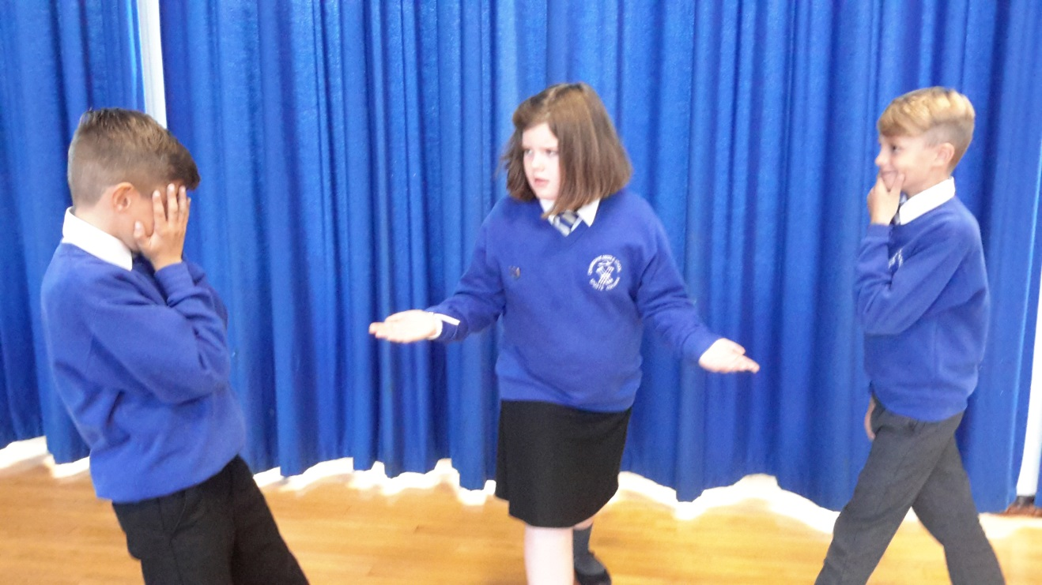
1. Macduff has just seen that King Duncan is dead.
O horror, horror, horror!
Ah!

Slide 3
1.
Oh dear! This is bad! They have figured out that the king has been murdered!

Slide 4
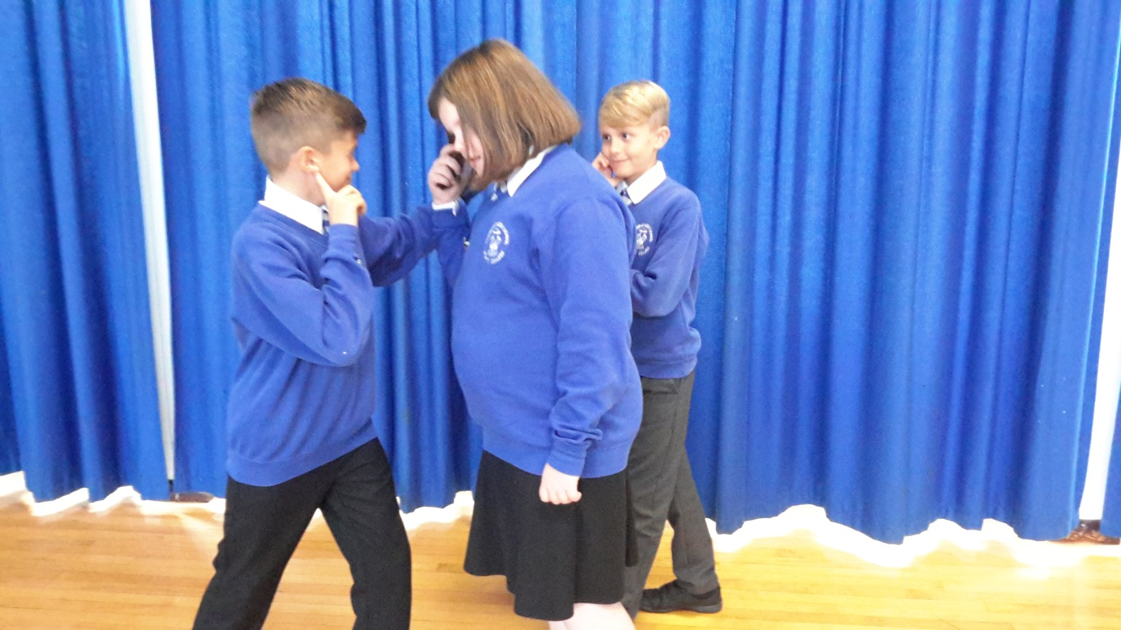
2. Lady Macbeth wants to know what is going on, but Macduff doesn’t let her.
O, gentle lady, tis not for you to hear what I can speak!
This is not your business.

Slide 5
2.
I need to carry on what I’m doing and not admit that I was part of this murder!

Slide 6
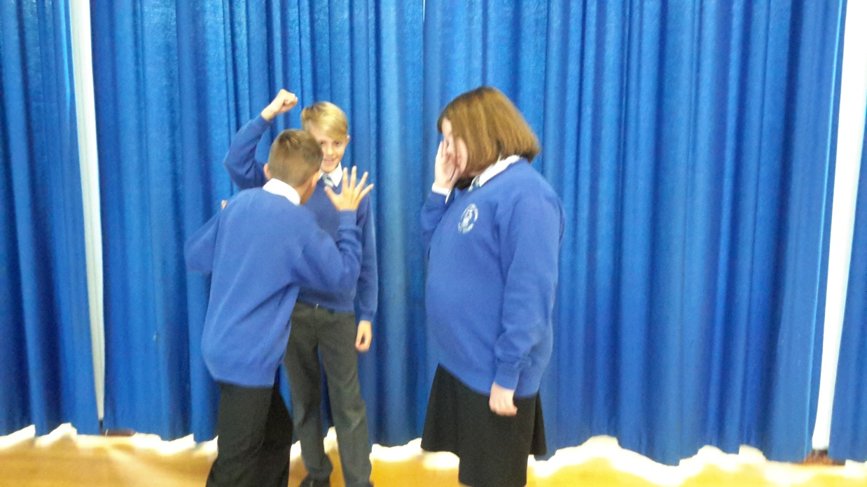
3. Lady Macbeth tries to draw the attention away from what they’re talking about (Macbeth is admitting he killed the guards).
Help me hence, ho!
Help me!

Slide 7
3.
What am I doing? I need to not admit I killed the guards!

Slide 8
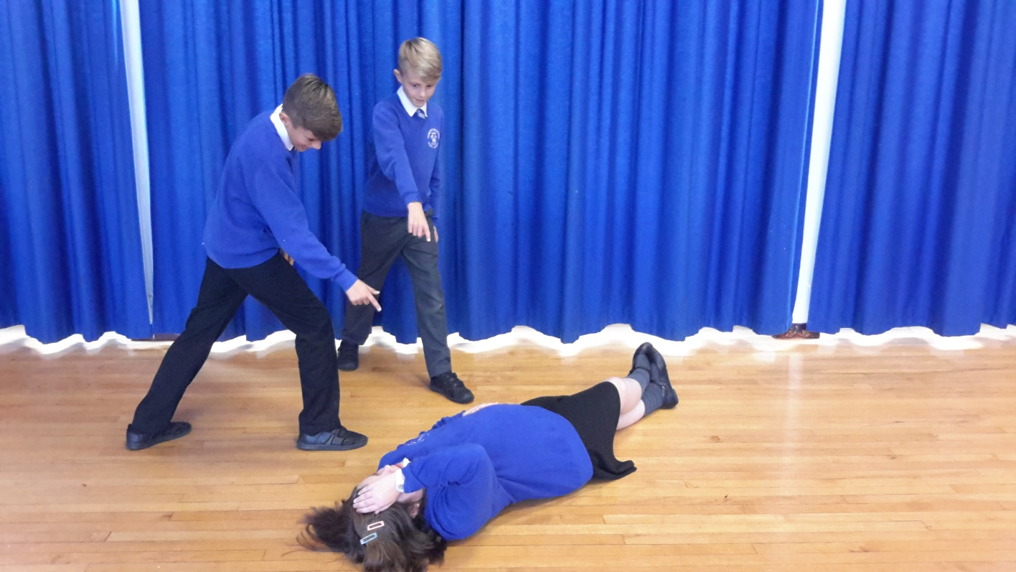
4. Lady Macbeth pulled the attention away from Macbeth by fainting.
Look to the lady!
Help her!

Slide 9
4.
I’m doing well! My stupid husband, what has he done, admitting he killed the guards?

