Slide 1
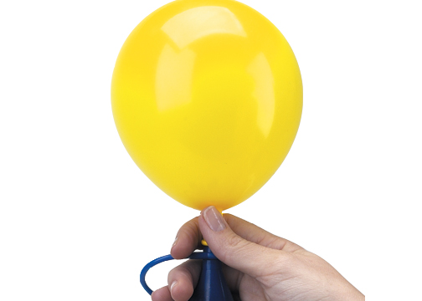
I understand the term
‘Pressure’
What is pressure?
Notes:
Begin by blowing up the balloon a small amount. Keep hold of it.
Think/ pair/ share the question.

Slide 2
What puts pressure on you?
Notes:
Blow the balloon up a little more. Where is the pressure? (Internal and external) What sort of things can increase or decrease the pressure?
Think/pair/share/discuss the question.

Slide 3
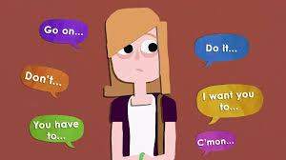
Notes:
Look at the picture and briefly discuss the images and any that weren’t covered in the previous discussion: friends, the media, tv, phones, exams, sport, school, social media, family, performances

Slide 4
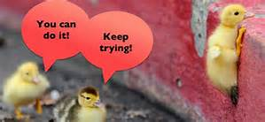
When can pressure be good?
Notes:
Blow up the balloon a little more
Think/pair/share the question.
Answers could include: motivating you and make you feel believed in, pushing you to do your best and potentially overcome fears, leading to better exam results/work – resilience

Slide 5
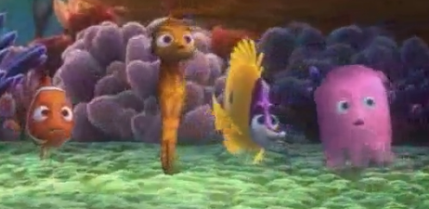
When can pressure be bad?
Click the picture to play.
Notes:
Blow up the balloon so it’s big and then discuss what will happen if you were to continue? What would happen if introduced to a pin?
Think/pair/share the question.
Answers could include: becoming overwhelmed, making bad decisions and taking risks, taking on more than you can handle, feeling stressed

Slide 6
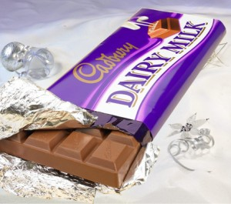
WALKING CHOCOLATE BAR
Fold your paper into 8 sections. Go round and talk to your classmates about things you could do to help cope with too much pressure.
You need 8 different strategies, so talk to someone else if somebody says one that you already have. You need to talk to at least 8 different people.
What strategies can we use to cope with too much pressure?
Notes:
Give pupils 10 minutes to do this. Walk round with anyone who is finding it difficult.

Slide 7
Coping with pressure
Notes:
Create a whole class mind map on the big paper by sharing ideas and suggestions. A couple of pupils can do the writing.

Slide 8
Some suggestions…
Always try to be organised and make a plan, so that everything doesn’t catch up with you at once.
If you feel like social media or your phone is controlling you, take some time away from it.
If a conversation online makes you feel under pressure, don’t be afraid to leave it.
Think about your choice of friends – if you know they are going to get you into trouble then perhaps this isn’t a good friendship and you should limit the time you spend with them.
Talk about your feelings.
Don’t be afraid to say no.
Notes:
SAVE THIS SLIDE – DON’T SHOW – IN CASE YOU’RE STRUGGLING FOR IDEAS!

