Slide 1
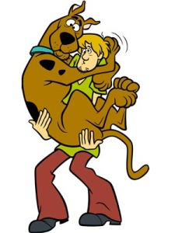
When do we not feel confident?
Notes:
Discuss this question with pupils and ask them to share times when they have not felt confident.

Slide 2
Trying something new
Notes:
What new things might we try at school/ home? Discuss why people might feel scared about trying something new.

Slide 3
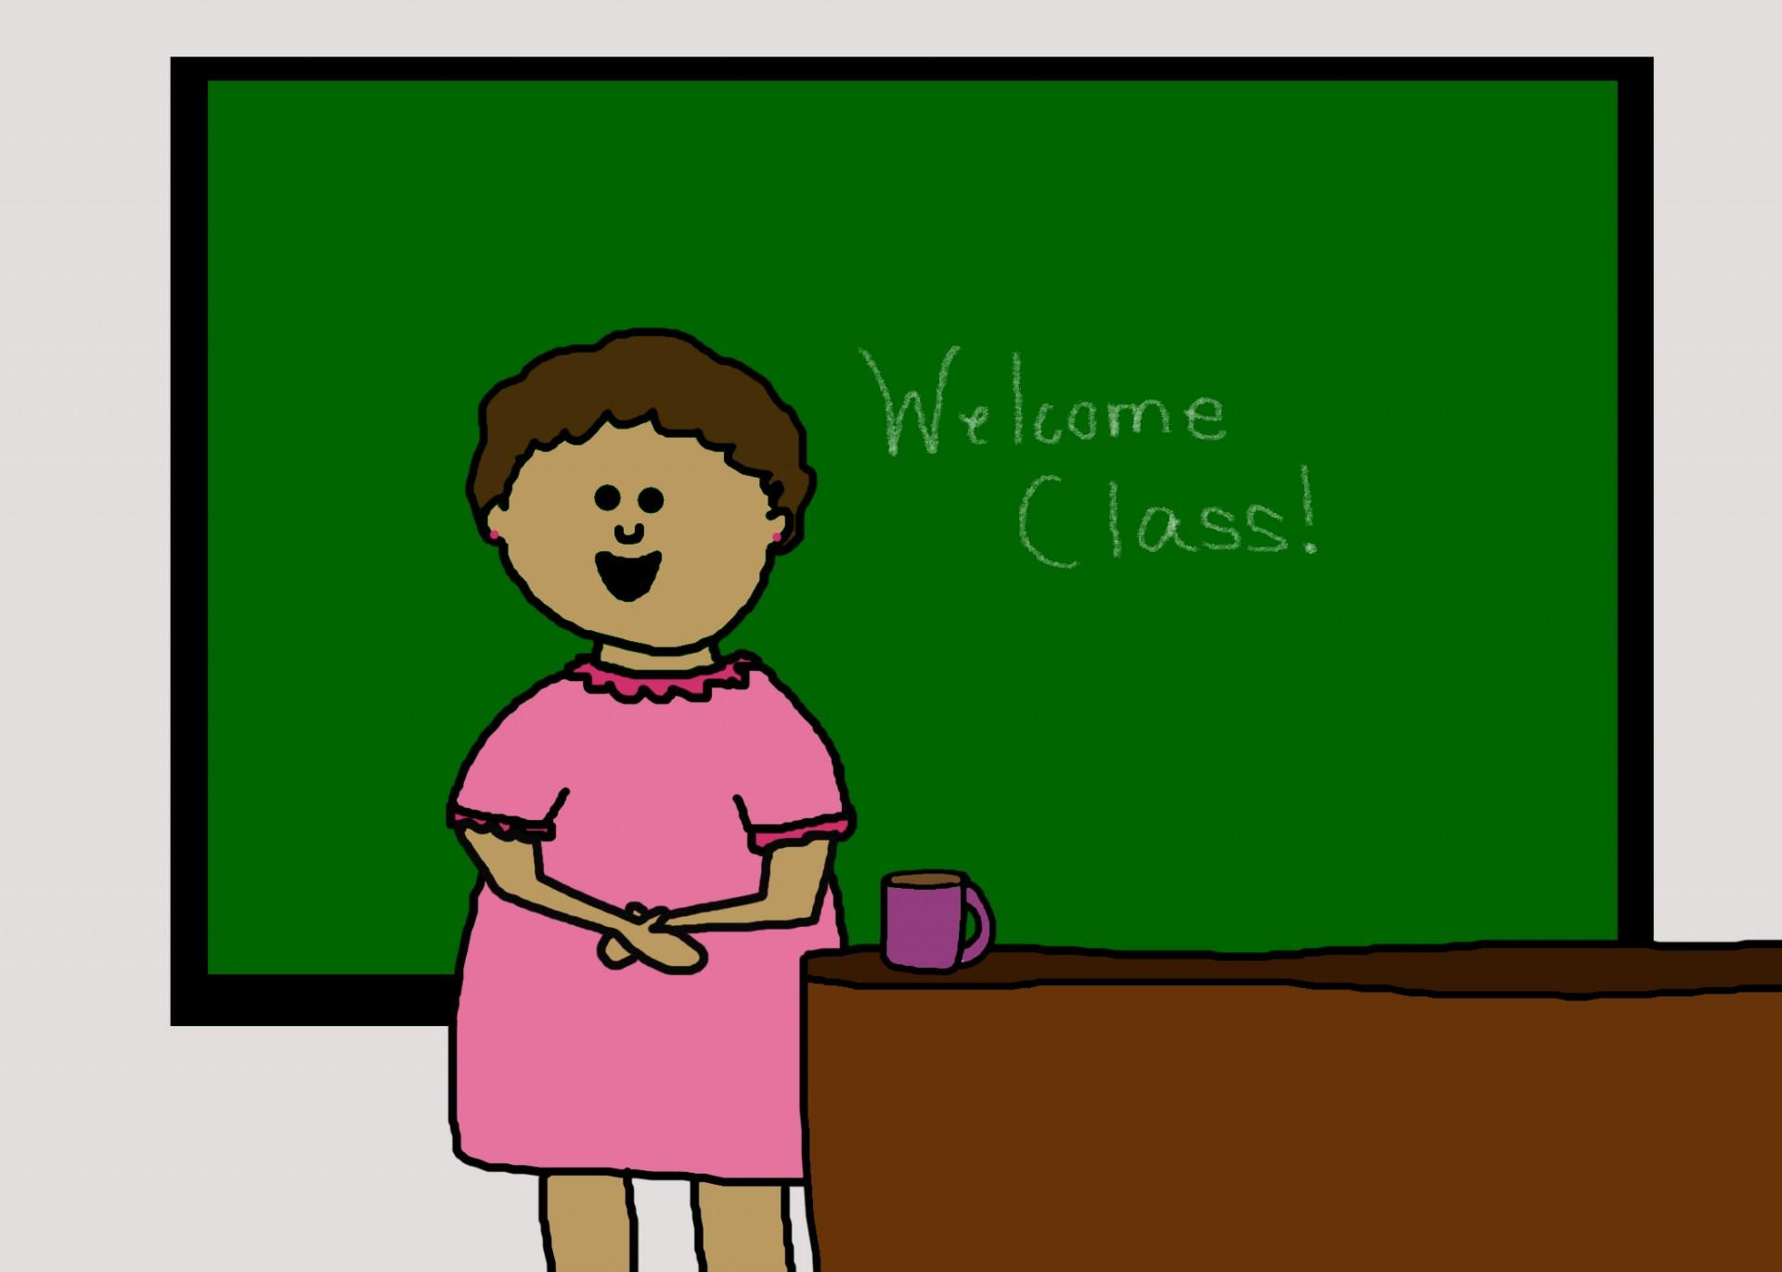
Change
Notes:
What could change at school to make us feel less confident? Discuss why people might feel scared about change.

Slide 4
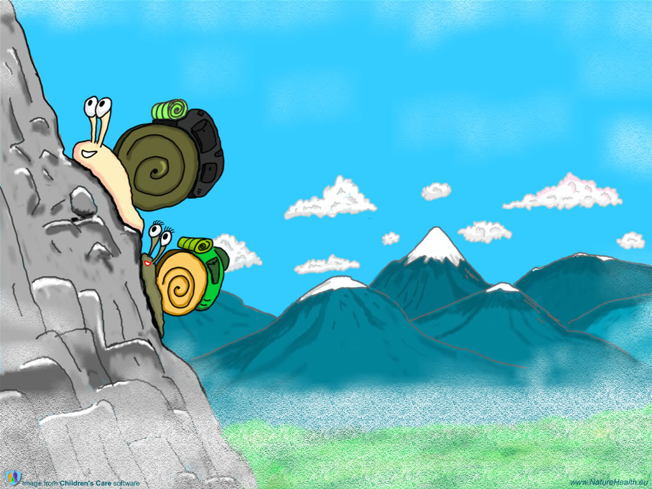
Challenge
Notes:
What challenges could we face? Discuss why people might feel scared about challenge.

Slide 5
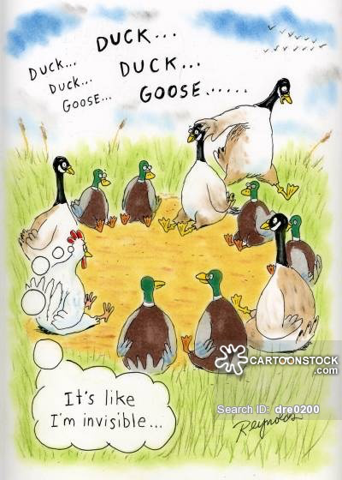
Feeling excluded
Notes:
How could we feel excluded? Discuss how this can make you feel.

Slide 6
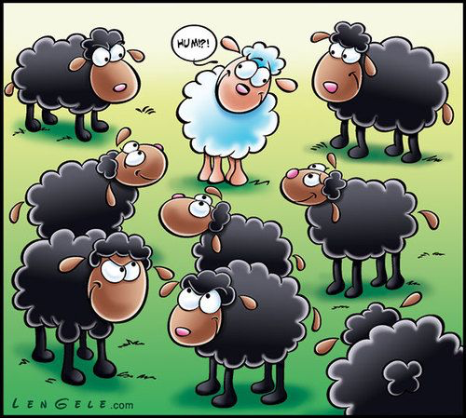
Being made to feel different
Notes:
How can we be made to feel different? Discuss why people might feel scared about being made to feel different.

Slide 7
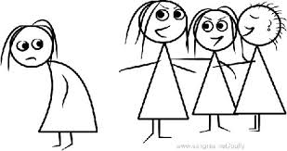
Not having things your friends have
Notes:
What things might we not have that our friends do? Discuss how this could make you feel.

Slide 8
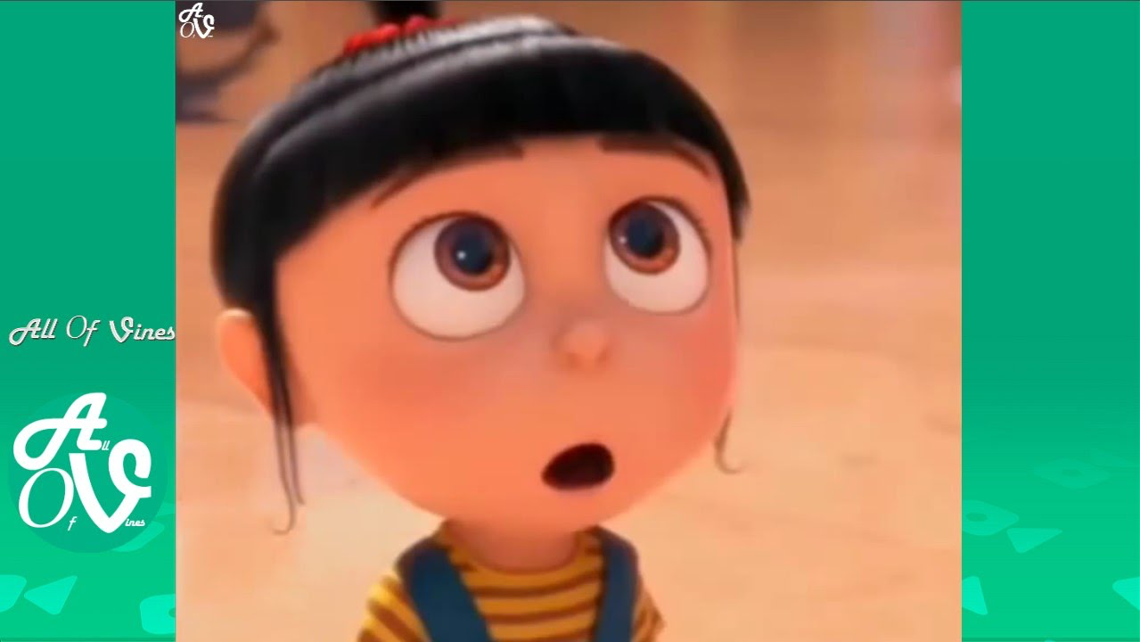
When you don’t feel like you’re good at something.
Notes:
When might we feel like we’re not good at something? How could this make you feel?

Slide 9
Freeze Frame:
Trying something new.
Being challenged.
Feeling left out.
Being made to feel different.
Not having things your friends have.
Change
Feeling that you’re not good at something.
Notes:
Put pupils into groups. They need to choose a bullet point and create a freeze frame about it. Show the freeze frames one at a time and interview pupils about who they are supposed to be and how they feel.

Slide 10
Always be aware
Sometimes people target those that are not feeling confident and try and make them do, or think things that they wouldn’t normally, so that they can feel like they fit in.
Notes:
Go through this with pupils and ask them to think of examples of when this might happen.

Slide 11
Radicalisation
Sometimes people, or groups of people can be influenced to follow extreme ideas. This is called radicalisation and can lead to dangerous acts.
Notes:
Read this slide and discuss the kind of things people can sometimes be persuaded to do in order to fit in.

Slide 12
Sam’s friends are always in trouble. They keep trying to persuade him to be naughty in maths. He doesn’t want to do this, but he does want to fit in. What could he do? | Annabelle has a younger sister called Sophie, who always seems to do better than her. This is making Anabelle feel sad. How can she build up her confidence?
Adam loves to play football at lunchtime. He was absent last week and ever since he’s come back, his friends ignore him and won’t let him play. How can he help himself? | Lizzie is dreading Friday. It’s a non uniform day and she feels like her friends have much more expensive clothes than her. What can she do to make herself feel better?
Notes:
Read the scenarios to pupils. Their task is to choose one in a group and spend 10 minutes creating a drama to solve it. Perform for the class and discuss how they have dealt with the issue and any other ideas to solve it. Make a note of solutions on the board.

Slide 13
Make a note in your diary of 3 strategies that you can use when you’re not feeling confident.
Notes:
Give pupils 2 minutes to do this.

